Slide 1
Color palettes

Slide 2
Color palettes
A color palette, in the digital world, refers to the full range of colors that can be displayed on a device screen or other interface, or in some cases, a collection of colors and tools for use in paint and illustration programs.
A color palette is a combination of colors used by UI designers when designing an interface. When used correctly, color palettes form the visual foundation of your brand, help to maintain consistency, and make your user interface aesthetically pleasing and enjoyable to use.

Slide 3
Color palettes
7 different kinds of color schemes?
The seven major color schemes are monochromatic, analogous, complementary, split complementary, triadic, square, and rectange (or tetradic). ... Let's examine each in more detail.
Monochromatic. ...
Analogous. ...
Complementary. ...
Split Complementary. ...
Triadic. ...
Square. ...
Rectangle.
Colours are there in color palette?
Dichrome palettes Each permuted pair of red, green, and blue (16-bit color palette, with 65,536 colors)

Slide 4
Color palettes
Color palette in computer?
In computer graphics, a palette is the set of available colors from which an image can be made.

Slide 5
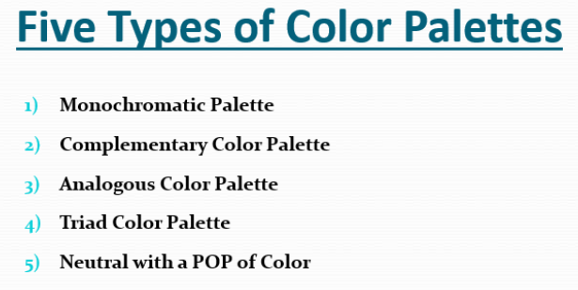
Color Palettes

Slide 6
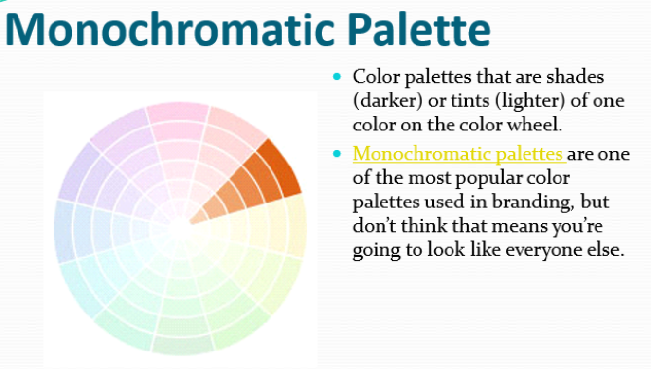
Color Palettes

Slide 7
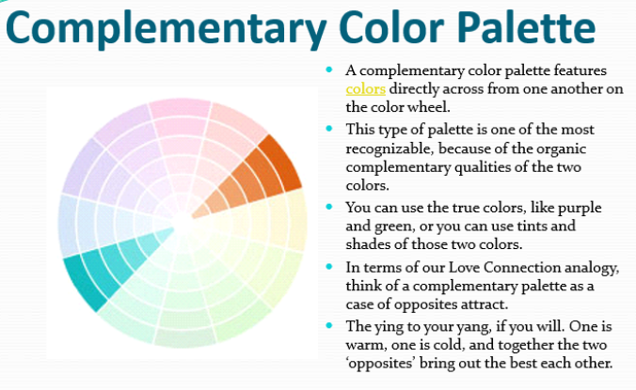
Color Palettes

Slide 8
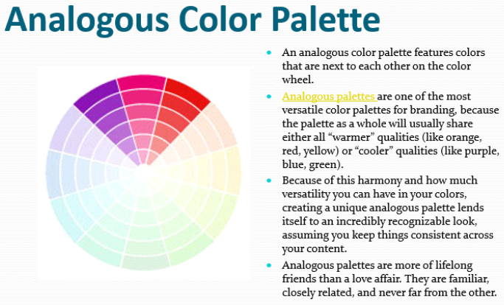
Color Palettes

Slide 9
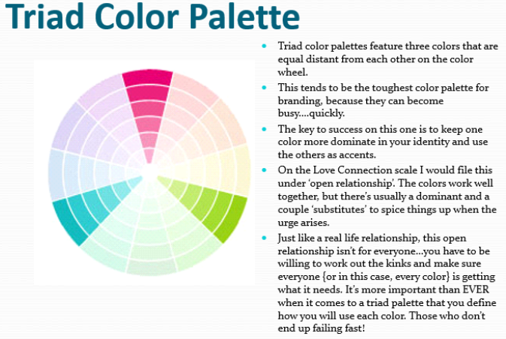
Color Palettes

Slide 10
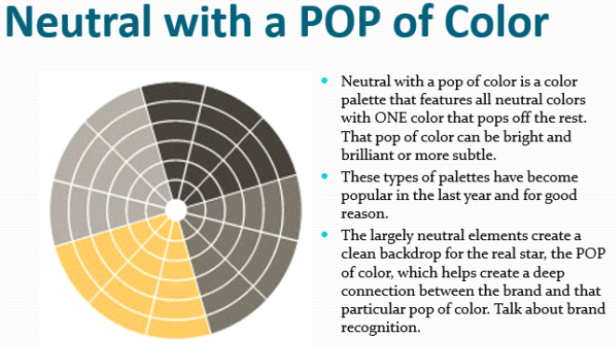
Color Palettes

Slide 11
Color Palettes
Adaptive Palette
Instead of specifying a Standard Palette that includes entries for any image, you can instead specify a palette that is restricted only to colors that are most appropriate for the image that you want to palettize. Such palettes are called Adaptive Palettes. Most modern graphics software can create an Adaptive Palette for any image automatically, so this is no longer a difficult proposition.

Slide 12
Color Palettes:-
Hardware Palette
In the early days of computer graphics, memory was expensive and capacities were small. It made economic sense to maximize the use of digital color palettes where possible, to minimize the amount and size of memory required. This was particularly important in the design of graphics display cards, which required sufficient memory to store at least one full frame of the display. By adding a small special area of memory on the card for use as a palette, it was possible to reduce the size of the main frame memory substantially. This was achieved at the expense of complexity, because now every image that was displayed had to have a palette.

Slide 13
Reference and text books:-
TEXT BOOKS
Tay Vaughan, “Multimedia making it work”, Tata McGraw-Hill, 2008.
Rajneesh Aggarwal & B. B Tiwari, “Multimedia Systems”, Excel Publication, New Delhi, 2007.
Li & Drew, “Fundamentals of Multimedia”, Pearson Education, 2009.
REFERENCE BOOKS
Parekh Ranjan, “Principles of Multimedia”, Tata McGraw-Hill, 2007
Anirban Mukhopadhyay and Arup Chattopadhyay, “Introduction to Computer Graphics and Multimedia”, Second Edition, Vikas Publishing House.

Slide 14
Any query ??

Slide 15

Thank you

